Slide 1
ECOSYSTEM
DR SHARMISTHA CHAKRAVARTY
DEPT OF ZOOLOGY
BARNAGAR COLLEGE,SORBHOG

Slide 4
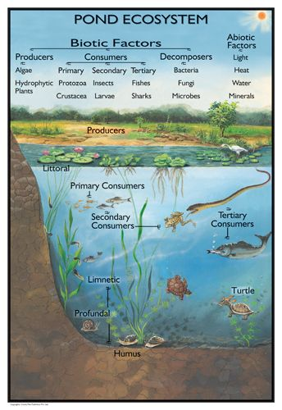

Slide 5
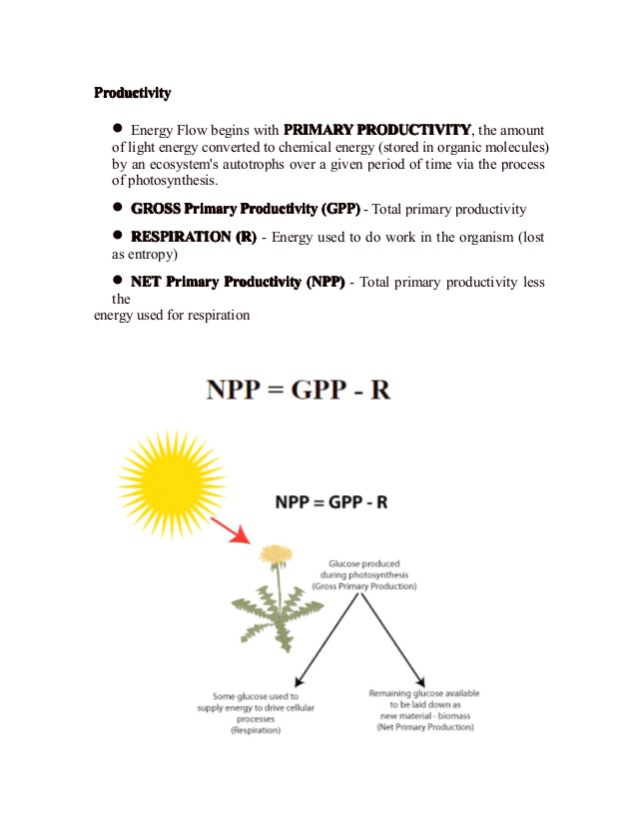

Slide 7
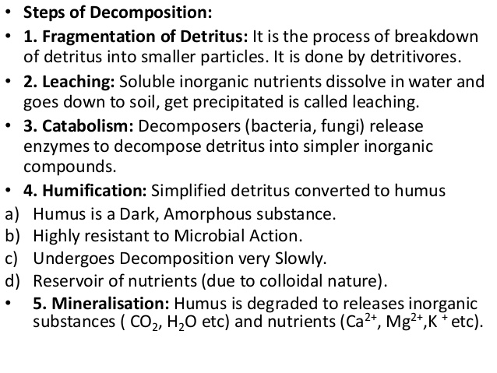

Slide 11
