Slide 1
EMBRYOLOGICAL AND PHYSIOLOGICAL EVIDENCES OF EVOLUTION
DR SHARMISTHA CHAKRAVARTY
DEPT OF ZOOLOGY
BARNAGAR COLLEGE,SORBHOG

Slide 2
introduction
Embryology is the study of development of embryo from zygote till it becomes an offspring. The different stages in the development of individual organs are known as ontogeny and the study of the history of development of species or race is called its phylogeny.
A comparative study of the development of the embryos, organs and organ systems provide number of evidences in support of evolution.

Slide 3
SIMILARITY IN EARLY DEVELOPMENT
Each animal whether an invertebrate or vertebrate starts its development from a single cell, the egg. This clearly indicates that all multi cellular organisms originated from a single celled ancestor. Again the embryological development of each and every animal there is cleavage, blastula and gastrula stages. These stages are fundamentally similar in all animals.

Slide 4
FATE OF GASTRULA

Slide 5
In all animals the gastrula consists of an archenteron, a blastopore and three germinal layers, namely ectoderm, mesoderm and endoderm.
The archenteron in all animals develops into the alimentary canal and the associated glands.
The blastopore develops into the mouth in all invertebrates except echinoderms and it develops into the anus in all chordates and echinoderms.
The three germ layers of gastrula develop into same type of organs and organ systems in all animals.

Slide 6
Similarity of embryos
Vertebrate embryos resemble one another in early stages and only an expert can differentiate a human embryo from the embryo of chick, lizard, frog or fish in early stages.
The embryos of closely related animals are more alike than those of distantly related animals.

Slide 7
Heart in vertebrates
The heart in all vertebrates follows the same pattern of development. In all of them it begins as a pair of tubular sturctures, the endocardial tubes which later fuse to form the primitive tubular heart. This simple straight tubular heart becomes ‘S’ shaped and later by the development of partition it develops 2 , 3 and 4 chambers

Slide 8
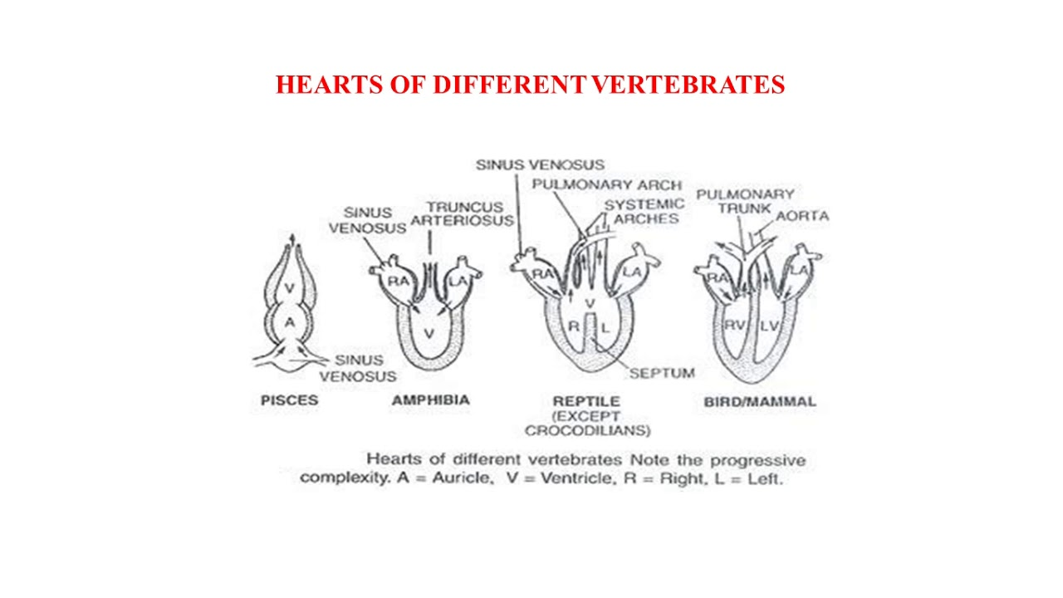

Slide 9
Aortic arches
In the development of the vascular system of the vertebrate embryos six pairs of aortic arches develop from the ventral aorta which later undergoes modifications in the adult.
In adult shark the first aortic arch drops out.
In amphibians and reptiles the first two aortic arches disappear and the third becomes the carotid. The fourth pair functions as the systemic arch while the fifth one disappears. The sixth becomes the pulmocutaneous.
In birds the left systemic arch disappears while in mammals the right one disappears.
Out of six original pairs of aortic arches only three persists in reptiles, birds and mammals. Yet all the six pairs develops in bird and mammal’s embryo.

Slide 10
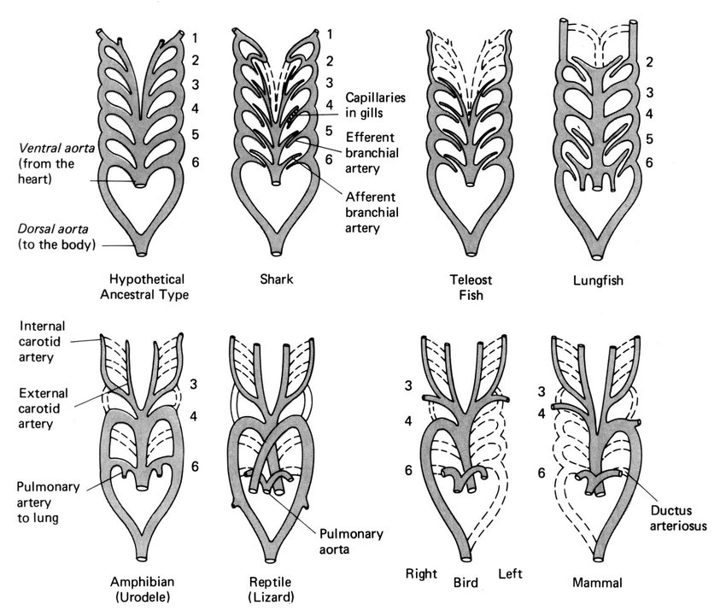

Slide 11
KIDNEY IN VERTEBRATES
All vertebrate embryos first develop a pronephric kidney from the anterior part of nephrostome eg hag fishes and a few bony fishes.
Mesonephros kidney is present in all bony fishes and amphibians and embryos of reptiles, birds and mammals.
Metanephros kidney in the adult forms of reptiles, birds and mammals.
In the ontogeny of development of kidneys in reptiles, birds and mammals there is a repetation of ancestral characters

Slide 12
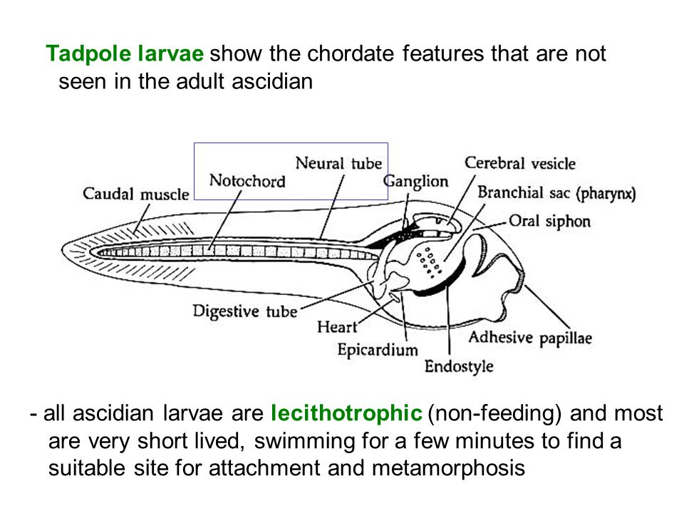
Retrogressive metamorphosis

Slide 13
Ontogeny of man
The fertilised egg resembles to a protozoan ancestor. Gastrulation forms a coelenterate like embryo.
Fundamental chordate characters (dorsal nerve tube, notochord, an pharynx are developed)
Fish like characters such as gill slits and aortic arches appear followed by tetrapod characters such as pentadactyl limb and mesonephric kidney, finally mammalian characters appears.

Slide 15
PHYSIOLOGICAL EVIDENCES OF EVOLUTION

Slide 16
Physiological evidences
One of the strong indirect evidence for evolution comes from the study of biochemistry of living organisms.
Protoplasm Chemistry: Biochemical analysis of protoplasm suggests that protoplasm from various organisms like bacteria, blue green algae, plants, animals has the same biochemical constitution.
Universal biochemical Organisation:
All organisms contains same type of molecules, genetic information is encoded in nucleic acid in DNA, RNA in all living organisms.
The genetic code is the same for almost all organisms.
ATP is used as energy currency in all life forms. Vital proteins, like ribosome, DNA polymerase, RNA Polymerase are found in all organisms from bacteria to human.

Slide 17
Enzymes and hormones
A large number of animals contain identical enzymes. For eg Trypsin, the protein digesting enzyme is found in protozoa to mammals. Amylase is found in sponges to man.
Hormones are also widespread in distribution. The hormones from thyroid gland of cattle can be used in treatment of human thyroid deficiencies.
When thyrodectomised frogs are fed upon mammalian thyroid tissue they undergo metamorphosis.
Melanophore expanding hormone of the amphibian also shows similarity with the mammalian counterpart.

Slide 18
Phosphagens
Phosphagens are energy rich compounds present in muscles. They supply energy for synthesis of ATP. Two types of phosphagens are present in animals chemically distinct from one another. The muscle of vertebrate contain phosphagen phosphocreatine or PC and muscle of invertebrate contain phosphagen phosphoarginine or PA. Amphioxus resembles vertebrates in having PC. Certain tunicates seem to have only PA and others only PC. Balanoglossus contains both PA and PC.

Slide 19
Metabolic processes and hemoglobin
The mechanism of protein synthesis is largely same in all living organisms. Energy in all living organisms is released by the biological oxidation of glucose and stored in ATP.
Glycolysis and Krebs Cycle are found to be similar in plants, yeasts, bacteria, protozoa, insects, chordates etc.
Hemoglobin: Proteins consist of long chains of amino acids and each protein differs in the number, type and sequence of its amino acids. The number of differences is used to indicate the relationship between organisms. A small difference indicates a recent divergence from a common ancestor. A large difference indicates a more distant, evolutionary relationship.

Slide 20
Differences in amino acid sequence of hemoglobin
Primate | Number of differences in amino acid sequence compared to human hemoglobin
Chimpanzee | 0
Gorilla | 1
Gibbon | 3
Orangutan | 4
Rhesus monkey | 8
Lemur | 5
These comparisons indicate that chimpanzee and gorillas are the nearest
relatives to humans.

Slide 21
Blood and lymph
The body fluids like blood, lymph and tissue fluid are similar in their composition and physiological role in all vertebrates. This indicates relationship among vertebrates. All vertebrates have hemoglobin in their RBCs, but in annelids it is dissolved in plasma.
Human beings have four blood groups A,B, AB and O. Apes are found to possess blood groups A and B but not monkeys. This indicates human beings are more closely related than to monkeys, though have common ancestry.

Slide 22
Excretory product analysis
An analysis of the urinary wastes of different species provides the evidence of evolutionary relationship. The kind of nitrogenous excretory waste depends upon the particular kinds of enzymes present, and the enzymes are determined by genes which have been selected in the course of evolution.
Vertebrate evolution has been marked by the successive loss of enzymes for the stepwise degradation of uric acid. J. Needhan made the interesting observation that the chick embryo in the early stages of development excretes ammonia, later it excretes urea and finally it excretes uric acid. The enzyme uricase, which catalyses the first step in the degradation of uric acid, is present in the early chick embryo but disappears in the later stages of development similarly adult frog excretes urea but its tadpole excretes ammonia.

Slide 23
Cytochrome C
Biochemistry also reveals similarities between organisms of different species. The protein cytochrome c essential for aerobic respiration is one of the universal compound. The universality of cytochrome c is evidence that all aerobic organisms descended from common ancestor that used this compound for respiration

Slide 24
Serological tests
Serology deals with the study of different aspects of blood serum. Serological tests by precipation method have been used for finding out evolutionary relationships between different animal groups. It has been found that precipation is more in closely related animals and reduces as the relationship becomes more distant.

Slide 25
THANK YOU
FOR FURTHER QUERIES
senorita1042001@gmail.com

