Slide 1
ENZYMES

Slide 2
STRUCTURE OF ENZYME

Slide 3
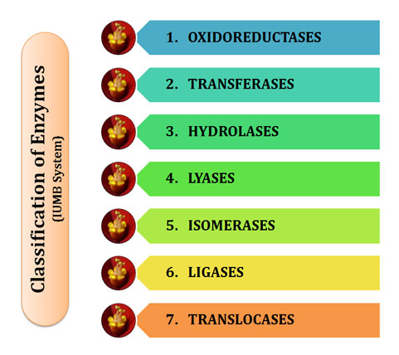

Slide 4
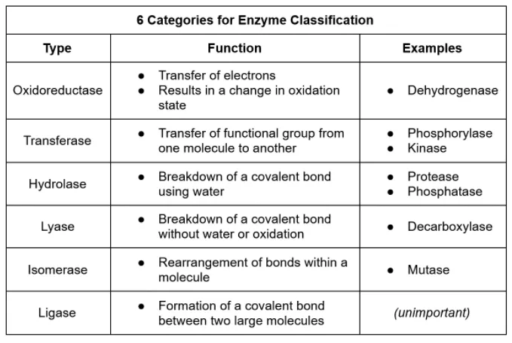

Slide 5
ACTIVATION ENERGY

Slide 6
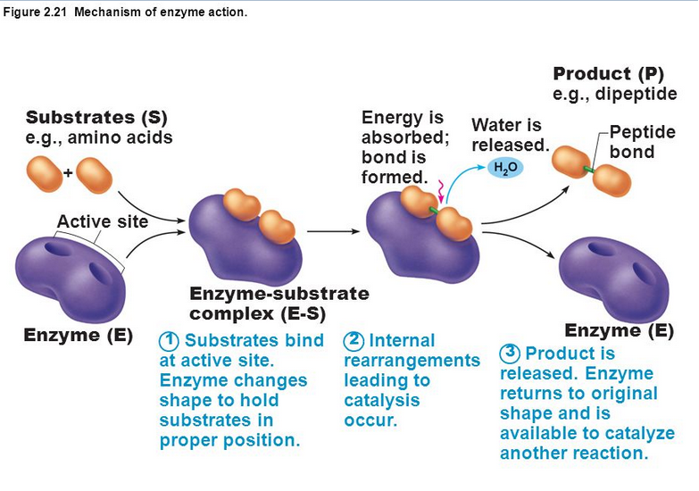

Slide 7
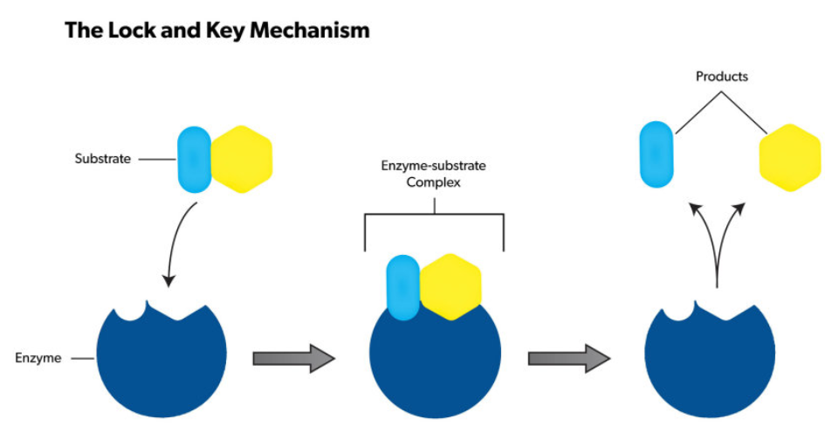

Slide 9
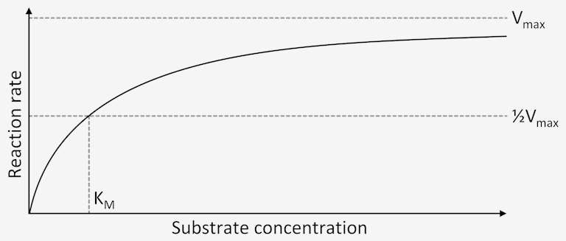
FACTORS EFFECTING ENZYME ACTIVITY

Slide 11
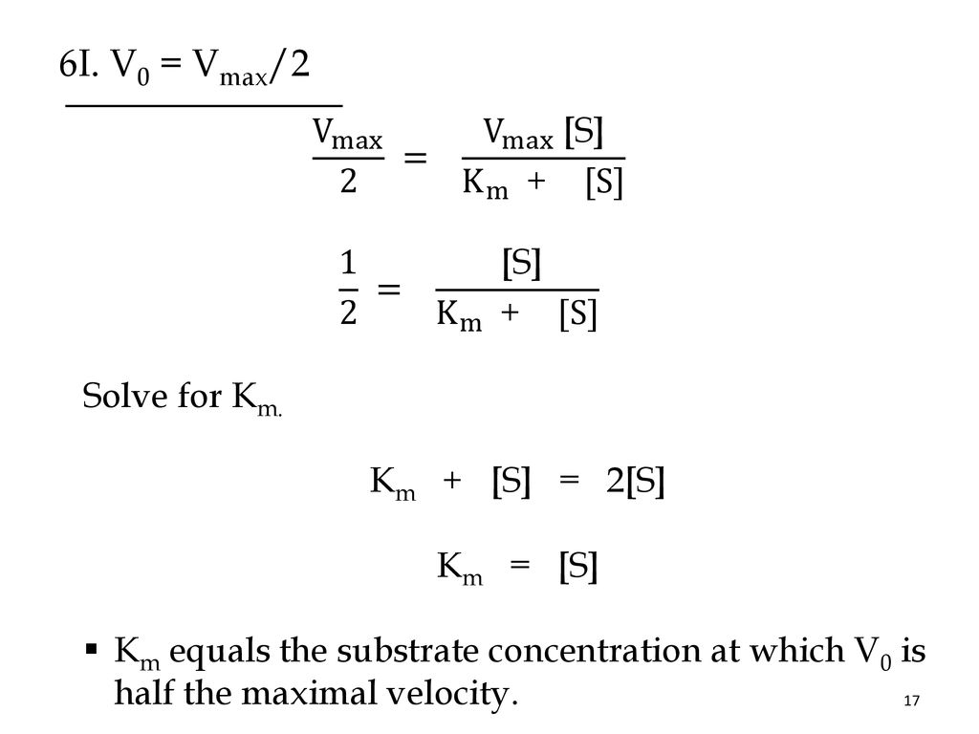

Slide 12
EFFECT OF PH AND TEMPERATURE ON ENZYME

Slide 14
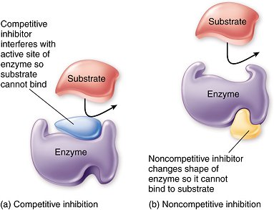
INHIBITION OF ENZYMES

